Slide 1

Course Design Report
陈培之 机国1801
2021年1月3日
指导老师：董惠敏 教授

Slide 2
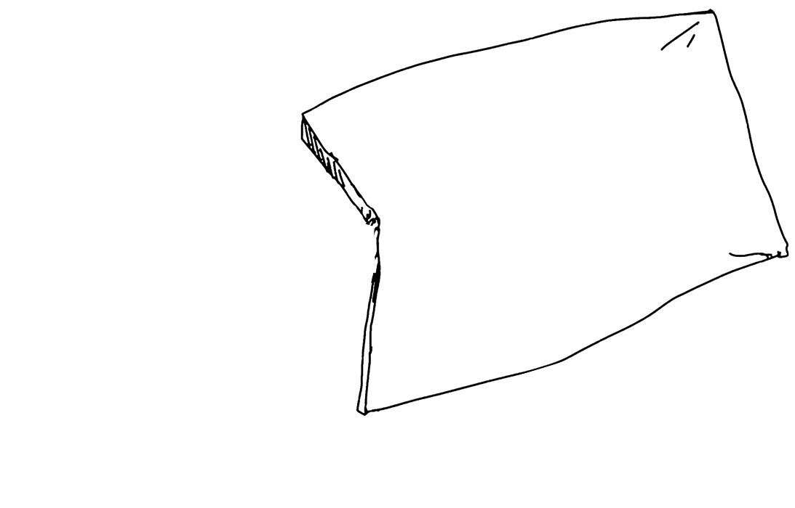

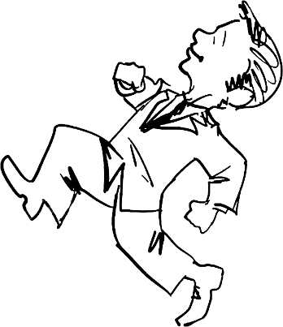
Content
Background
Dimensional Design
Analysis and Simulation of the Mechanism
Dynamic analysis and dynamic balance

Slide 3
Background

Slide 4
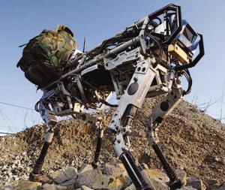
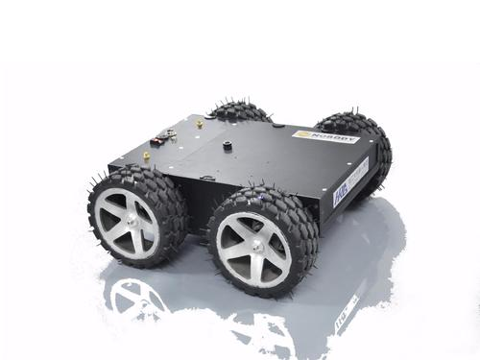
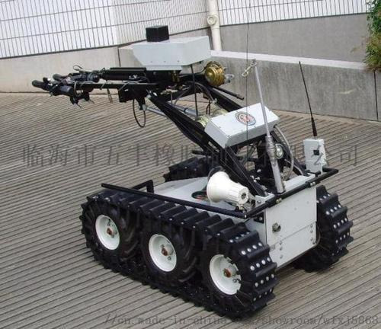
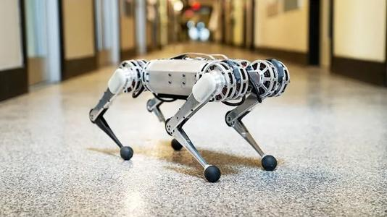
Background & Classification：
Robots are commonly used in our daily life and have a better prospect, because they have high mobility, high adaptability, and strong load capacity.
In the last century, world’s first two four-legs working robots named ‘Phony pony’ and ‘Mosher’ were made in American.
Mobile robot can be divided into wheeled robots, crawler robots and walking robots, the biggest difference between them is their moving part, which are consist of wheels, crawlers, and links.

Slide 5
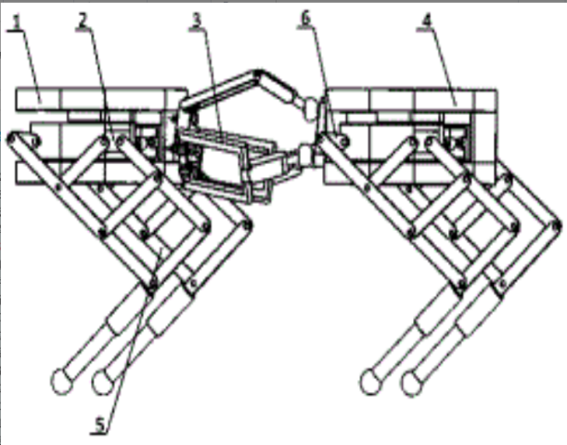
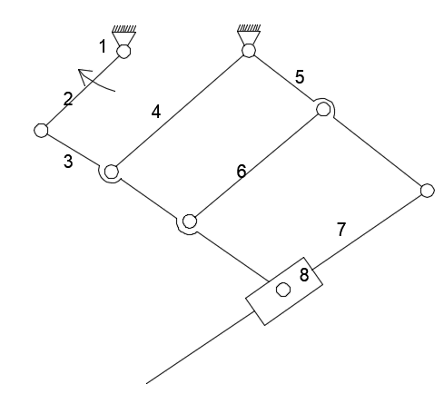
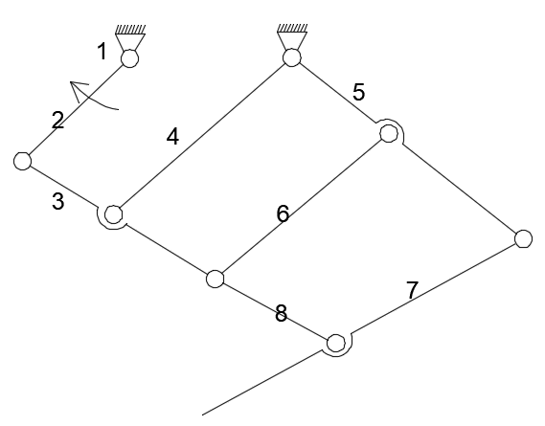
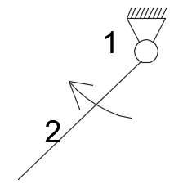
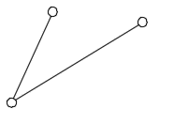
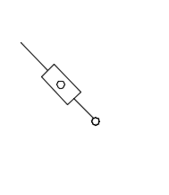
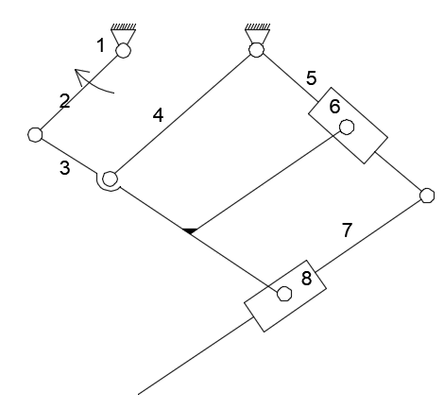
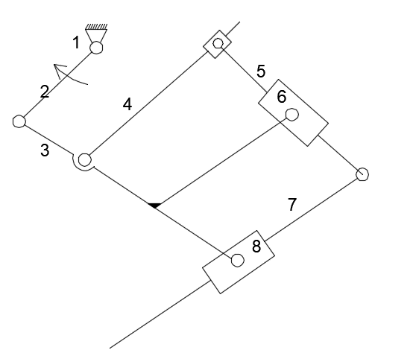
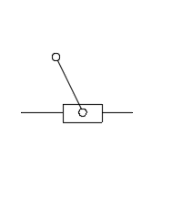
Patent
After replacing the original assur-groups of the patent (CN201810627660.0) structure, we can get following conditions:
Series | Driving Link | Basic assur-group 1 | Basic assur-group 2 | Basic assur-group 3 | Scheme sketch
1
2
3

Slide 6
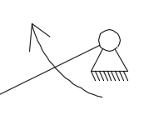
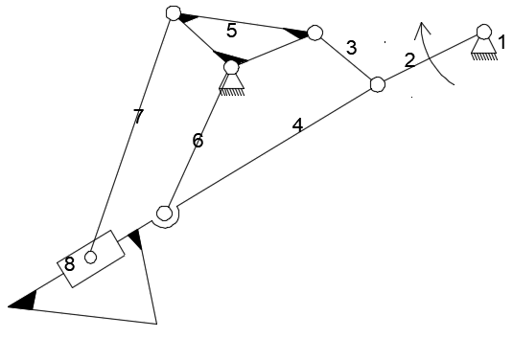
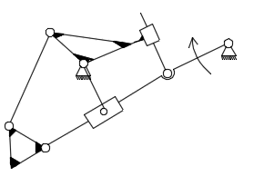
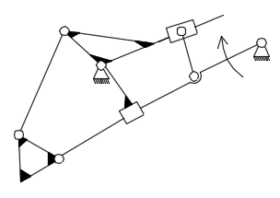
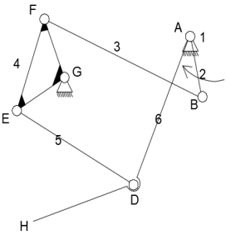
After doing assur-group replacement for the initial jansen linkage, we find the most suitable case for the next step.
Series | Driving Link | Basic assur-group 1 | Basic assur-group 2 | Basic assur-group 3 | Scheme sketch
1
2
3
4

Slide 7
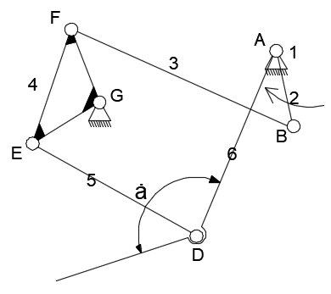
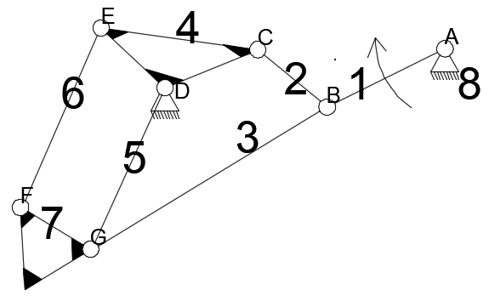
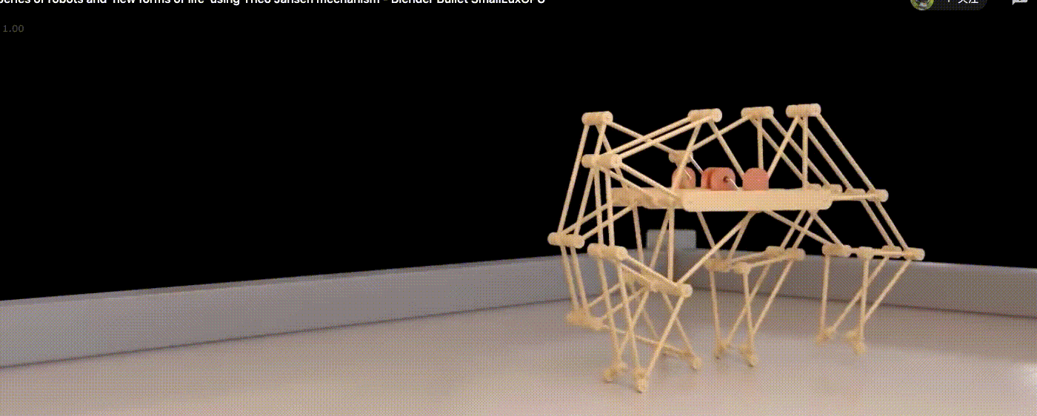
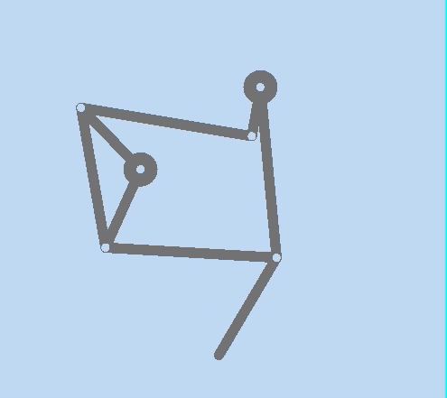
Jansen Mechanism

Slide 8
Dimensional design

Slide 9
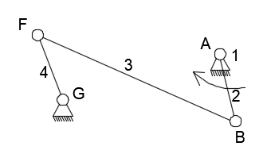
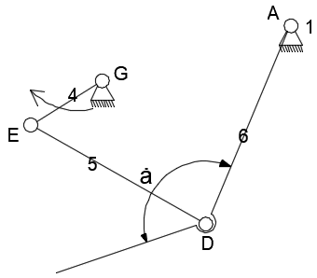
split the new six-bar mechanism into two parts, the upper part has a quick return characteristic (quick return coefficient K=1.4), and the lower part can make an arc trajectory with a certain step length by adjusting the length of AD(DE) and angle α

Slide 10
Known Conditions:
1, the straight length of AG is 85mm, FG=EG=50mm.
2, The trajectory is an arc with a horizontal distance of 108mm.
3, rotation angle of bar 4 is 90°.
Solution:
1, the first four bar linkage has a quick return characteristic, by given the quick return coefficient, we can determine the length of it.
2, for the second four bar linkage, we will use two position function synthesis method to determine the length.

Slide 11
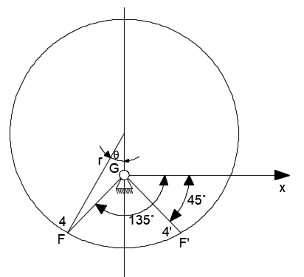
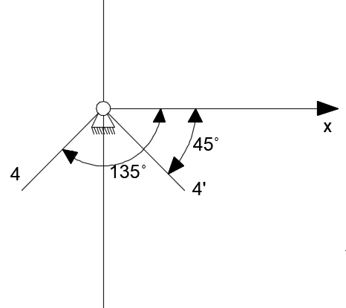
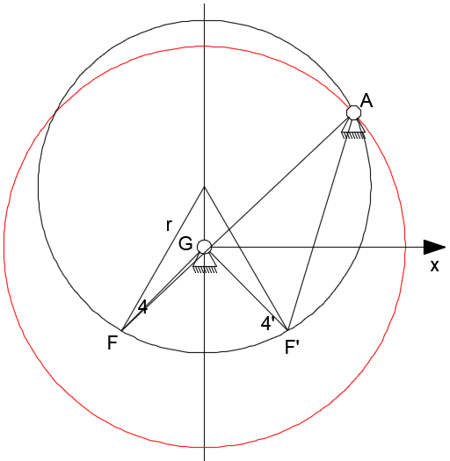
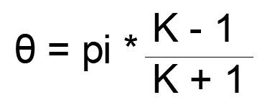
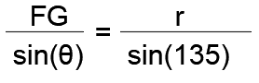
Step 3: The distance G and A is 85 mm, we then draw a circle passing through point G with radius of 85mm. The coincident point of the two circle is A. Since GF and GF’ are limited position, we can get the length of AB and BF.
Graphical method:
Step 3: The distance between G and A is 85 mm, we then draw a circle passing through point G with radius of 85mm. The coincident point of the two circle is A. Since GF and GF’ are limited position, we can get the length of AB and BF.
Step1: Draw the limited region of bar 4, which is shown in the following picture:
Step1: Draw the limited region of bar 4, which is shown in the following picture:
Step 2: By using the quick return coefficient K=1.4, we can get the radius of the circle which passes through A.
We can get θ= 30°
The length of AB = (AF - AF’)/2 = 29mm, the length of BF = AF - AB = 101mm.
Finally, we can get the length of the quick return part, AB=29mm, BF=101mm, FG=50mm,AG=85mm. Since AB + BF < FG + AG, which satisfies the Grashof kinematic chain conditions. The coordinate of A(70,48 ).
FG = 50mm, we can get r = 71mm

Slide 12
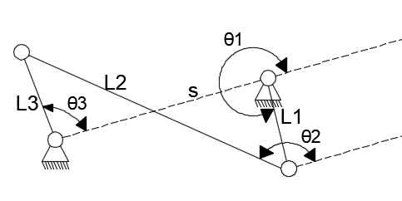
Analytic method to prove:
Given that FG = 50 mm, and AG = 85 mm
By given dimensions and limited angles, we can find the relationship between 4 bars. The process of deduction is as follows:
S + L1*exp(i*θ₁) + L2*exp(i*θ₂) = L3*exp(i*θ₃)
S + L1*cos(θ₁) + L2*cos(θ₂) = L3*cos(θ₃)
L1*sin(θ₁) + L2*sin(θ₂) = L3*sin(θ₃)

Slide 13
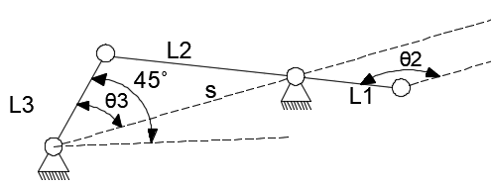
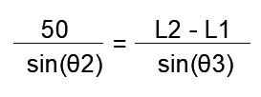
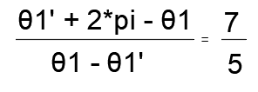
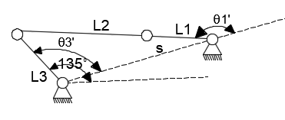
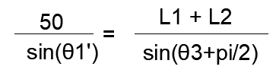
position 1, where the angle between L3 and horizontal is 45°
Let L1 = 29 mm and L2 = 101 mm, then we can check whether the K satisfy.
position 2, where the angle between L3 and horizontal is 135°

Slide 14
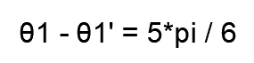
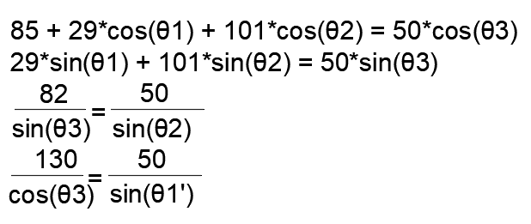
Then we can get:
(4.6)
By substituting the L1=29mm and L2=100mm to check whether the quick return coefficient is 1.4.
By solving the equations, we can get θ1 = 326.4° and θ1’ = 116.4° , which satisfy the equation (4.6)

Slide 15
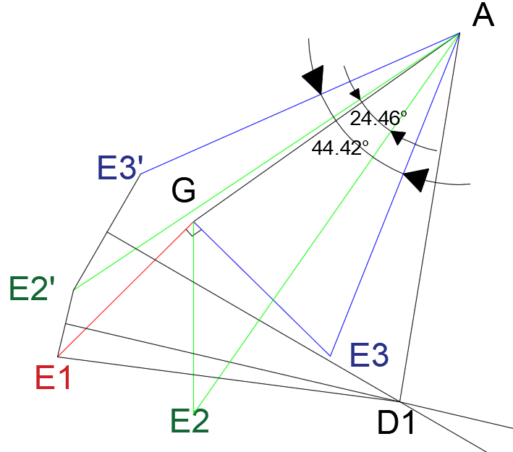
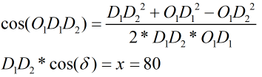
Analytic method (second four bar linkage):
Given that GE = 50 mm, and AG = 85 mm
For the second four bar mechanism, I use the function generation method to determine the length of each bar, by reversing the frame from AG to AE, and draw the plumb lines of E₁E₂,E₂E₃, we can get the size of AD and DE:
Known Conditions:
∠E_{2'}AE₂ = 24.46°, ∠E_{3'}AE₃ = 44.42°, ∠E₁GE₂ = ∠E₂GE₃ = 45°.
Let l = ED/EG, m = AD/EG, n = AG/AE = 1.7, we can list the following equations:
l*cos(θ2i) = n + m*cos(51.61+θ3i) - cos(10.44+θ1i)
l*sin(θ2i) = m*sin(51.61+θ3i) - sin(10.44+θ1i)
In the first limited position, θ3i= 24.26°, θ1i= 45°.
In the second limited position, θ3i= 44.42°, θ1i= 90°.
Finally, we can solve that AD = 98.03mm and ED = 98mm
Solving δ :

Slide 16
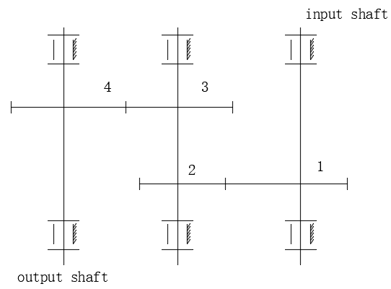
Part 2: Design of driving mechanism
Aim: the output speed of the motor is very large, we need to use gear reducer to adjust the output speed of the motor to a reasonable value.
Known conditions:
1, the output speed of the motor is 490r/min.
2, the crank needs to rotate 40 turns per minute, which means the mechanism can make 40 steps per minute. (40r/min)
2.1 Gear train design:
the gear reducer’s transmission ratio is i = 12.25 (8 ~ 60), two-stage reducer is satisfied. In the gear reducer, we use the expansion gear train.
From the fixed-axis gear train, we can get:
i14 = w1/w4 = i12 * i34 = (z2*z4) / (z1*z3)

Slide 17
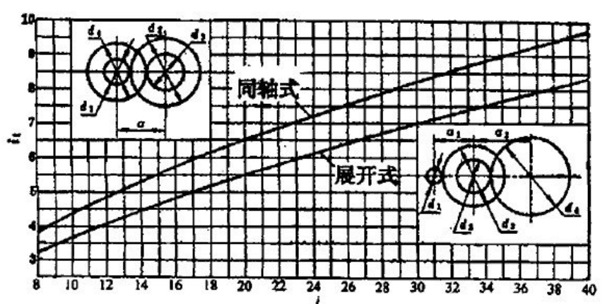
i14 = w1/w4 = i12 * i34 = (z2*z4) / (z1*z3)
principles:
1, Equal strength principle:
The high-speed transmission ratio is slightly larger than that of the low-speed.
2, The transmission ratio of each level should be determined in accordance with the principle of gradual reduction.
distribution diagram of transmission ratio of two-stage cylindrical reducer:
After checking the corresponding transmission ratio distribution diagram:
we can approximately choose i₁₂ = 4.375, i₃₄= 2.8
Transmission ratio error:
δ= |i14-i14’|/i14 * 100%
= (12.25-4.375*2.8)/12.25 * 100%
= 0 < 0.5%

Slide 18
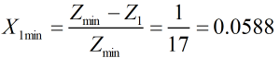
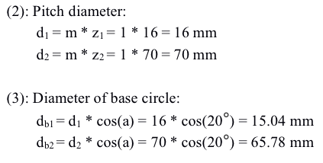
2.2 Gear parameters design:
Number of teeth, which is Z₁=16, Z₂=70, Z₃=20, Z₄=56
2.2.1 parameters of high-speed gear:
Known conditions:
Number of teeth: Z1=16, Z2=70, pressure angle is 20 degree, addendum height coefficient ha*=1, coefficient of bottom clearance c*=0.25, modulus m=1 mm, since the number of teeth of gear 1 is less than that of the minimum number of undercutting teeth, high-speed gears need to be modified.
minimum modification coefficient X_{1min}:
X1 is taken as 0.1. X2 is taken as 0.03.

Slide 19
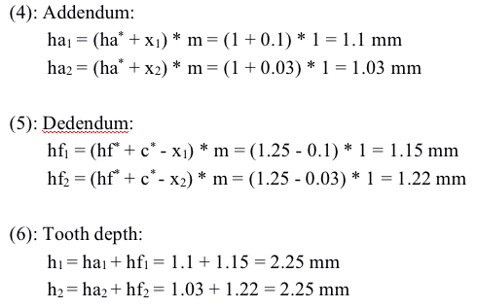
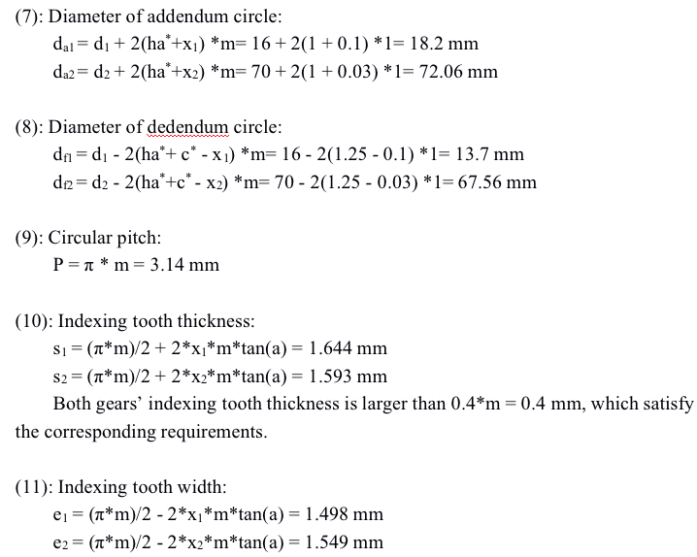

Slide 20
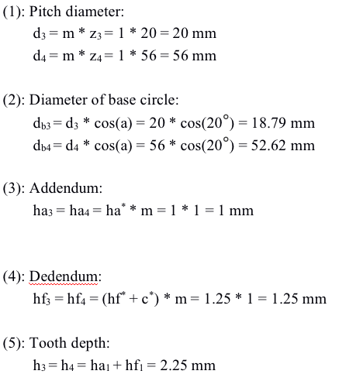
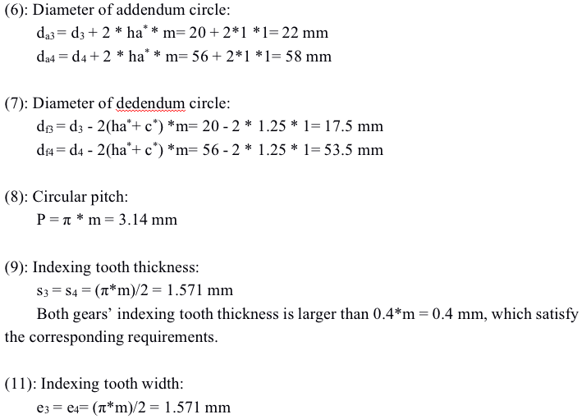
2.2.2 parameters of low-speed gear:
Number of teeth: Z3=20, Z₄=56, pressure angle is 20 degree, addendum height coefficient ha*=1, coefficient of bottom clearance c*=0.25, modulus m=1 mm.

Slide 21
Analysis and Simulation of the Mechanism

Slide 22
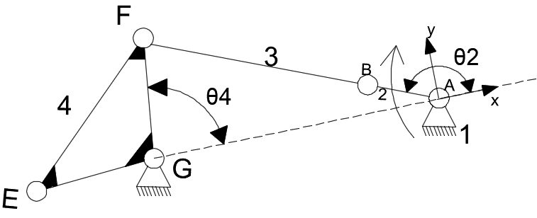


Building Mathematical Model
To begin with, we just separate the mechanism into two parts, which are shown in the following pictures:

Slide 23


Analyze the output trace by mathematical method
Sol: The input is the rotation of bar 2 with an angular velocity w₁, and we want to find the output angular velocity of bar 4, which is the input angular velocity of next four-bar linkage. Finally we can get the displacement of point F, which can represent the displacement of the output trace.
Calculate θ₃ and θ₄

Slide 24




Corresponding w₃ and w₄
Corresponding a₃ and a₄
Output of the first four-bar linkage will be the input of the next four-bar linkage.

Slide 25




Finally, we can use mathematical method to get the corresponding angular velocity and angular acceleration of the output (Point F).

Slide 26






Analyze by Matlab & Adams
X&Y displacement
Matlab
Adams

Slide 27




Analyze by Matlab & Adams
X&Y velocity
Matlab
Adams

Slide 28




Analyze by Matlab & Adams
X&Y acceleration
Matlab
Adams

Slide 29
Dynamic analysis and dynamic balance

Slide 30
Force analyze of mechanism
Assumptions for connection and self-properties:
1, The friction force at the joint of each component can be ignored.
2, The force acting on the connecting rod is concentrated force and the inertial force acting on the center of mass as a concentrated force.
3, The connecting rod force acts as a concentrated force at the middle point of the crank pin and the internal force acts as a concentrated force at the mass center of the crank.
4, The mass distribution of the connecting rod is uniform, 0.5kg per 10mm.
Known parameters and undetermined parameters
m₂=1.5 kg, m₃=5 kg, m₄=9.15 kg, m₅=m₆=5 kg;
J₃=0.00417 kg*m², J₄=0.00345 kg*m², J₅=J₆=0.00417 kg*m².
Length parameters of each components:
L2=29 mm, Lc2=14.5 mm.
L3=101 mm, Lc3=50.5 mm.
L4=50mm,Lc4= 44.7mm. (mass center is located at the intersection of three central lines)
L5=100 mm, Lc5=50 mm.
L6=100 mm. Lc6=50 mm.
The angle between the connecting line of two frames and the positive half axis of x-axis is 34.56 degree.

Slide 31

Motion parameters of each components:
acceleration of the mass center of link 2: ac2x=-(w2)2*(L2/2)*cos(θ2+θ), ac2y=-(w2)2*(L2/2)*sin(θ2+θ)
acceleration of the mass center of link 3:
acceleration of the mass center of link 4:
acceleration of the mass center of link 5:
Parameters to be solved:
Unknown forces of each pairs:
the force between the frame and link 2: F_{12x} and F_{12y};
the force between the frame and link 6: F_{16x} and F_{16y};
the force between the frame and link 4: F_{14x} and F_{14y};
reaction force between link 2 and link 3: F_{23x} and F_{23y};
reaction force between link 3 and link 4: F_{34x} and F_{34y};
reaction force between link 4 and link 5: F_{45x} and F_{45y};
reaction force between link 5 and link 6: F_{56x} and F_{56y};
Unknown balance torque M_{c2};
acceleration of the mass center of link 6:
corresponding moment of inertia: Mc3= -J3*a3; Mc4= -J4*a4; Mc5=-J5*a5

Slide 32

Force analyze of each component
Force analysis of link 2:
F_{12x} + F_{c2x} + F_{32x} = 0 (1)
F_{12y} + F_{c2y} + F_{32y} - m₂g = 0 (2)
M_{c2} + (L₂/2) * F_{23x} * sin(θ+θ₂) - (L₂/2) * F_{23y} * cos(θ+θ₂) + (L₂/2) * F_{12x} * sin(θ+θ₂) - (L₂/2)* F_{12y} * cos(θ+θ₂) = 0 (3)
Notice that:
F_{c2x} = m₂ * a_{c2x}; F_{c2y} = m₂ * a_{c2y}; F_{32x} = - F_{23x} ; F_{32y} = - F_{23y}

Slide 33

Force analyze of each component
Force analysis of link 3:
F43x + Fc3x + F23x = 0 (4)
F43y + Fc3y + F23y - m3g = 0 (5)
Mc3 + (L3/2) * F23x * sin(θ+θ3 )- (L3/2) * F23y * cos(θ+θ3 ) - (L3/2) * F43x * sin(θ+θ3 ) + (L3/2)* F43y * cos(θ+θ3 ) = 0 (6)
Notice that:
Fc3x = m3 * ac3x; Fc3y = m3 * ac3y;

Slide 34

Force analyze of each component
Force analysis of link 4:
F_{14x} + F_{c4x} + F_{34x} + F_{54x}= 0 (7) F_{14y} + F_{c4y} + F_{34y} + F_{54y} - m₄g = 0 (8) M_{c4} + r * F_{14x} * sin(90.56 + θ₄) - r * F_{14y} *cos(90.56 + θ₄) + r * F_{54x} * sin(22.56 + θ₄) - r * F_{54y} * cos(22.56 + θ₄) - r * F_{34x} * sin(201.44 - θ₄) - r * F_{34y} * cos(201.44 - θ₄)= 0 (9)
Notice that:
Fc4x = m4 * ac4x; Fc4y = m4 * ac4y; F54x = - F45x ; F54y = - F45y

Slide 35

Force analyze of each component
Force analysis of link 5:
F_{45x} + F_{c5x} + F_{65x} = 0 (10)
F_{45y} + F_{c5y} + F_{65y} - m₅g = 0 (11)
M_{c5} - (L₅/2) * F_{45x} * sin(θ+θ₅) + (L₅/2) * F_{45y} * cos(θ+θ₅) + (L₅/2) * F_{65x} * sin(θ+θ₅) - (L₅/2) * F_{65y} * cos(θ+θ₅) = 0 (12)
Notice that:
Fc5x = m5 * ac5x; Fc5y = m5 * ac5y; F65x = - F56x ; F65y = - F56y

Slide 36

Force analyze of each component
Force analysis of link 6:
F_{56x} + F_{c6x} + F_{16x} = 0 (13)
F_{56y} + F_{c6y} + F_{16y} - m₆g = 0 (14)
M_{c6} - (L₆/2) * F_{16x} * sin(θ+θ₆) + (L₆/2) * F_{16y} * cos(θ+θ₆) + (L₆/2) * F_{56x} * sin(θ+θ₆) - (L₆/2) * F_{56y} * cos(θ+θ₆) = 0 (15)
F_{56x} + F_{c6x} + F_{16x} = 0 (13)
F_{56y} + F_{c6y} + F_{16y} - m₆g = 0 (14)
M_{c6} - (L₆/2) * F_{16x} * sin(θ+θ₆) + (L₆/2) * F_{16y} * cos(θ+θ₆) + (L₆/2) * F_{56x} * sin(θ+θ₆) - (L₆/2) * F_{56y} * cos(θ+θ₆) = 0 (15)
Notice that:
Fc6x = m6 * ac6x; Fc6y = m6 * ac6y;
Notice that:
Fc6x = m6 * ac6x; Fc6y = m6 * ac6y;

Slide 37


Force analysis results
F₁₂
Matlab
Adams

Slide 38


Force analysis results
F₁₆
Matlab
Adams

Slide 39




Force analysis results
F₁₄
Matlab
Adams

Slide 40


Force analysis results
F₂₃
Matlab
Adams

Slide 41


Force analysis results
F₄₅
Matlab
Adams

Slide 42


Force analysis results
F₅₆
Matlab
Adams

Slide 43


Force analysis results
M_{c2}
Matlab
Adams

Slide 44


Dynamic Balance of the mechanism
Compared with symmetric method, the counterweight method is less complex, after checking out which link’s inertia force influences the overall inertial force most, we can add counterweight to its opposite direction to balance the inertia force. After comparing each bar's tribute to the overall inertial force and inertial moment, we find bar 4 influences the overall most, so we need to add a counterweight on it:

Slide 45






Total shaking force on the fixed support:
Fx = F12x + F16x +F14x’
Fy = F12y + F16y +F14y’
Total balancing moment on the fixed support:
M = Mc2’
Total inertial force on the fixed support:
Fix = Fc2x + Fc3x +Fc5x+Fc6x+Fc4x
Fiy = Fc2y + Fc3y +Fc5y+Fc6y+Fc4y
Total inertial moment on the fixed support:
M = Mc3+Mc4+Mc5+Mc6
Total inertial force in x-axis
Total inertial force in y-axis
From the picture we can see that it eliminates major inertial force of the frame, however, by adding counter weight into the mechanism, the total balancing moment and total shaking force is increase.
Total inertial moment
Total shaking force in x-axis
Total shaking force in y-axis
Total balancing moment

Slide 46
Thanks!
陈培之
201861199
2021年1月3日
指导老师：董惠敏 教授

